Slide 1













AO* Algorithm

Slide 2
Problem Statement
The problem statement is to study and implement the AO* algorithm, a heuristic search algorithm based on problem decomposition, for efficient pathfinding in dynamic environments.
The algorithm focuses on decomposing the problem into smaller pieces, calculating a cost function (F(n) = G(n) + H(n)) where H represents the heuristic or estimated value of nodes, and G represents the actual cost or edge value (with a unit value of 1 in this case).
The problem involves developing a robust implementation of the AO* algorithm, focusing on effective problem decomposition and heuristic evaluation.
The algorithm's performance will be evaluated in dynamic environments where the cost of edges is uniform (1) and the heuristic values play a crucial role in determining the optimal path

Slide 3
Approaches
Brute Force Method
A* Search Algorithm
This approach involves systematically exploring all possible states of the puzzle until the goal state is reached. While guaranteed to find a solution if one exists, it is generally impractical due to the vast number of possible states, resulting in exponential time complexity.
A* search combines the advantages of informed and uninformed search by using a heuristic function to guide the search towards the goal state efficiently. It evaluates nodes based on a combination of the cost to reach them from the start and an estimate of the cost to reach the goal from them.
01.
02.
Dijkstras Algorithm
AO* Algorithm
This approach involves systematically exploring all possible states of the puzzle until the goal state is reached. While guaranteed to find a solution if one exists, it is generally impractical due to the vast number of possible states, resulting in exponential time complexity.
The AO* (AO star) algorithm is a heuristic search approach designed for solving problems represented by And-Or graphs, emphasizing problem decomposition and a cost function This algorithm efficiently explores the graph, dynamically adapting to changes and providing an optimal path.
03.
04.

Slide 4

AO* Algorithm
START: Create an initial graph with a single node (start node).
Transverse the graph following the current path, accumulating node that has not yet been expanded or solved.
Select any of these nodes and explore it. If it has no successors then call this value- FUTILITY else calculate f'(n) for each of the successors.
If f'(n)=0, then mark the node as SOLVED.
Change the value of f'(n) for the newly created node to reflect its successors by backpropagation.
Whenever possible use the most promising routes, if a node is marked as SOLVED then mark the parent node as SOLVED.
If the starting node is SOLVED or value is greater than FUTILITY then stop else repeat from Step-2.

Slide 5
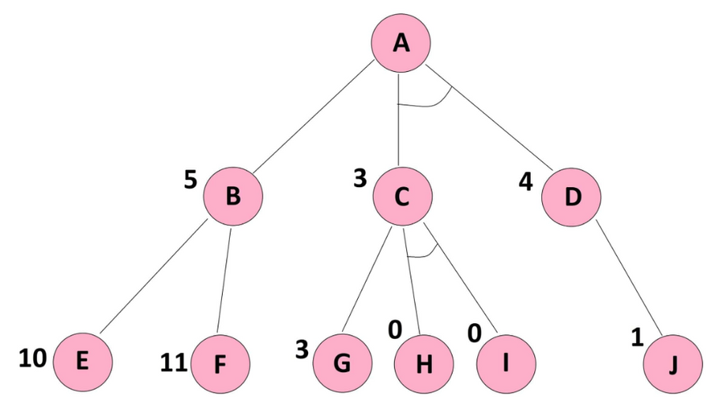
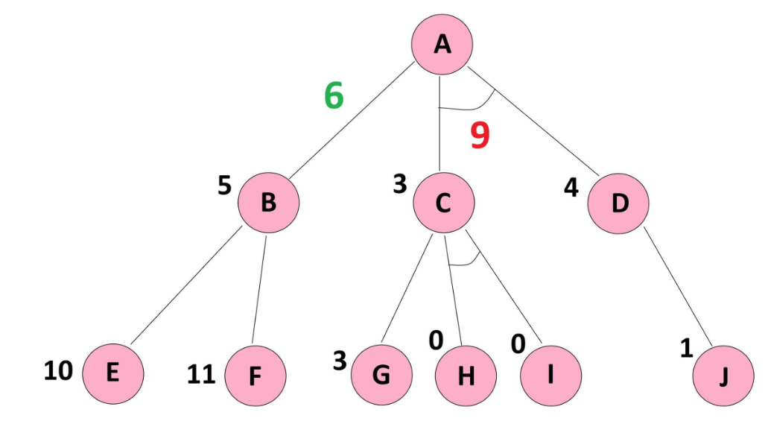
Example
f(n) = g(n) + h(n)
g(n): actual cost from start node to n
h(n): estimate cost from n to Goal node
Note: For simplicity, the value for g(n) for all the edges is taken as 1
f(A-B) = g(AB) + h(B)
f(A-B) = 1 + 5 = 6
As there is an And Symbol f(A-CD) will be
f(A-CD) = g(AC) + h(C) + g(AD) + h(D)
f(A-CD) = 1 + 3 + 1 + 4 = 9

Slide 6



Example
f(A-B) is smaller then f(A-CD)
Hence we will take the A->B path.
Now similarly calculate the f(n) values for
f(B-E) and f(B-F)
f(B -F) = g(BF) + h(F)
f(B -F) = 12
f(B -E) = g(BE) + h(E)
f(B -E) = 11
Here, f(B-E) has a lower cost and would be
chosen

Slide 7

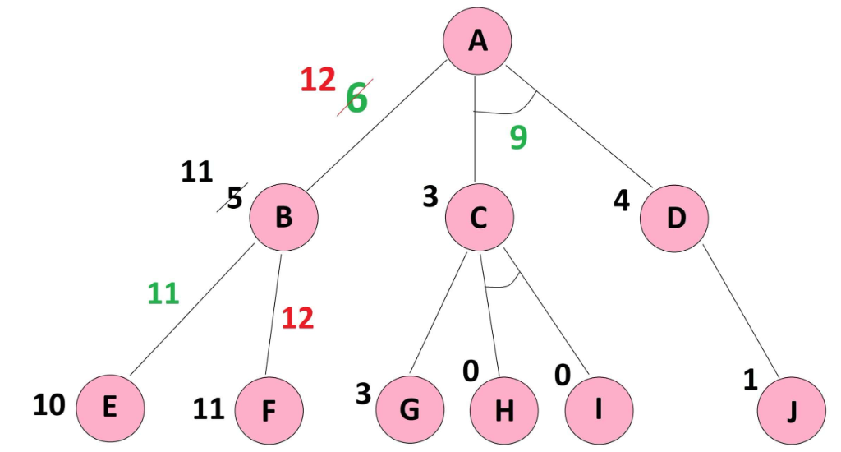

Example
We have reached the leaf node now we shall back track
Therefore, we can do the backpropagation and correct the heuristics of upper levels
the updated , and as a consequence the updated .
The updated value of h(B) = f(B-E) = 11
and as a consequence the updated
f(A-B) = f(B) + updated h(B) = 1 + 11 = 12

Slide 8

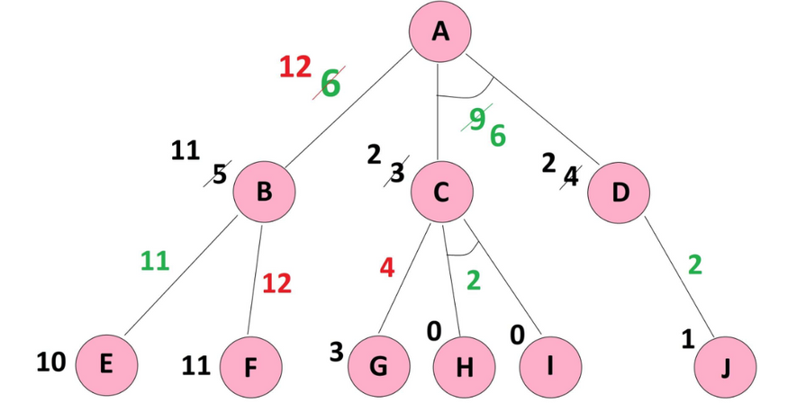
Example
Similarly we have to do for other branches
The updated f(A-C-D) with the cost of 6 is still less then the updated f(A-B) with the cost of 12, and therefore, the minimum cost path from A to the goal node goes from
f(A-C-D) by the cost of 6. We are done.

Slide 9












Advantages & Disadvantages
Pros | Cons
Finds the best path (if the guesstimate is good). Saves time by focusing on promising paths first. Adaptable to different problems with different guesstimates (heuristics). | Can be computationally expensive for very complex problems. Relies on a good guesstimate (heuristic) - a bad one can lead it astray. Might miss the best path if the guesstimate is overly optimistic.

Slide 10
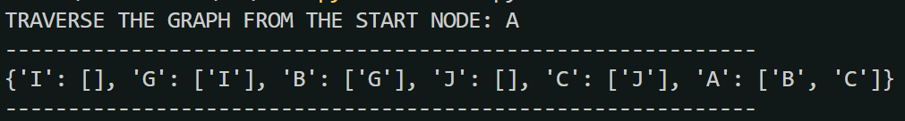


Results
Implementation:-
Document

Slide 11

THANK YOU

